Slide 1


IIMT STANDARDS 2020
  NAME : VIRAJ RAJUBHAI SHEKHDA
  SEM : 4th
  SUB : ANALOG AND DIGITAL COMMUNICATION(01CT0404)
Task Based assignment Presentation
FACULTY : PROF. HARSHUL YAGNIK
COLLEGE :MARWADI UNIVERSITY

Slide 2
IMT & ITS EVOLUTION
IMT – International Mobile Telecommunications
IMT-2000 technologies (known as 3G):
IMT-Advanced technologies (Marketed as 4G):
International Mobile Telecommunications-2020 (IMT-2020 Standard) are the requirements issued by the ITU Radiocommunication Sector (ITU-R) of the International Telecommunication Union (ITU) in 2015 for 5G networks, devices and services

Slide 3
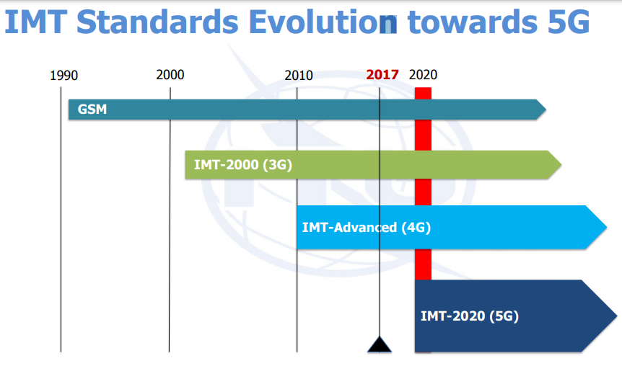
CREDIT TO OFFICIAL ITU WEBSITE

Slide 4
Partners & Approvals
ITU-R WP 5D is working together with these partners in the same open process to establish the criteria for IMT-2020
Recommendation ITU‑R M.2083‑0, approved in September 2015, defines the framework and overall objectives of the future development of IMT for 2020 and beyond.
The ITU Radiocommunication Assembly held in Geneva, 26-30 October 2015, approved Resolutions ITU-R 65 and 56-2 that establish the roadmap for the development of 5G mobile and the term that will apply to it: “IMT-2020”.

Slide 5
WHY WE NEED IMT-2020?
User and application trends
Very low latency and high reliability
High user density- Cell size is being reduced (e.g. some tens of meters)
High quality at high mobility (UHD)
Enhanced multimedia services
Internet of Things
Convergence of applications (e-Gov, e-health,…)- New markets segments
Ultra-accurate positioning applications
Global operation and economies of scale

Slide 6
IMT-2020 Network Overview
What it Covers ?
IMT-2020 [ITU-R M-2083-0]includes system components, and related aspects that support to provide far more enhanced capabilities than those described in Recommendation ITU-R M.1645.
IMT-2020 Radio includes IMT evolution + new RAT revolution
IMT-2020 Network incudes flat architecture + white-box-hardware + Virtualization + LINP/ Slices + Softwarization + MEC + DAN (ICN/ CCN) + e-2-e VoLTE enabling

Slide 7
Requirement Criteria
IMT-2020 is not just an increase in BW from the previous releases of IMT systems; but rather a fundamental change to support new emerging capabilities
5G requirements will be different because of the wide range of use cases creating distinctly different “wants” and potentially separate sets of requirement values
IoT, “Typical” Wireless Broadband, Video and other higher bandwidth applications (e.g, above 6 GHz)

Slide 8
Bandwidth used in network
Existing mobile allocation
24.25 GHz – 27.5 GHz
31.8 – 33.4 GHz
37 – 40.5 GHz
40.5 – 42.5 GHz
42.5 – 43.5 GHz

Slide 9
Bandwidth used in network
No global mobile allocation
45.5 – 47 GHz
47 - 47.2 GHz
47.2 -50.2 GHz
50.4 – 52.6 GHz
66 – 76 GHz
81 – 86 GHz

Slide 10
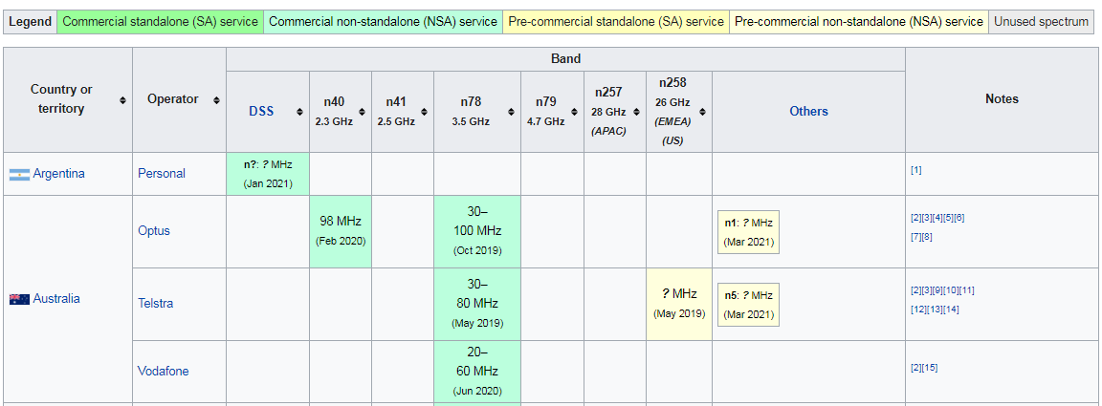
BANDWIDTH BAND AND ALLOCATIONS
CREDIT TO OFFICIAL WIKIPEDIA

Slide 11
IMT-2020 Terms & Definition
Slice: Logically isolated set of programmable infrastructure resources (i.e., physical and/or logical resources) to enable functions and services of IMT-2020 network.
Network Softwarization: Automation mechanism for the configuration deploying, managing and maintaining of network equipment and network components.
FMC: Capabilities that provide services and application to the end user regardless of the fixed or mobile access technologies being used and independent of the user's location.

Slide 12
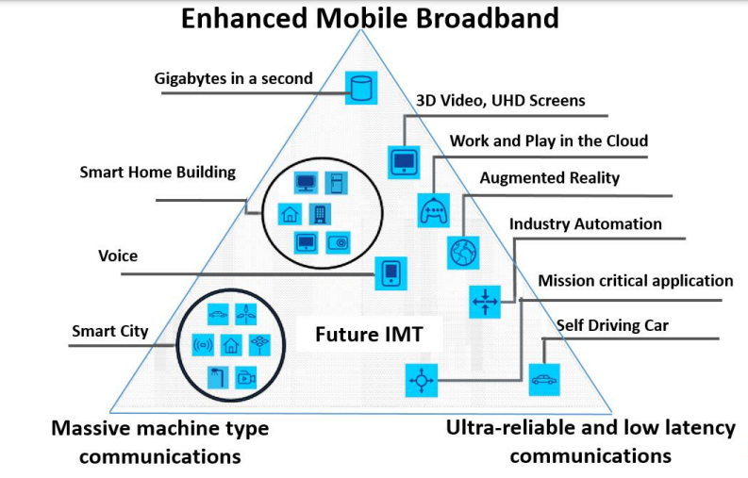
CREDIT TO OFFICIAL ITU WEBSITE

Slide 13
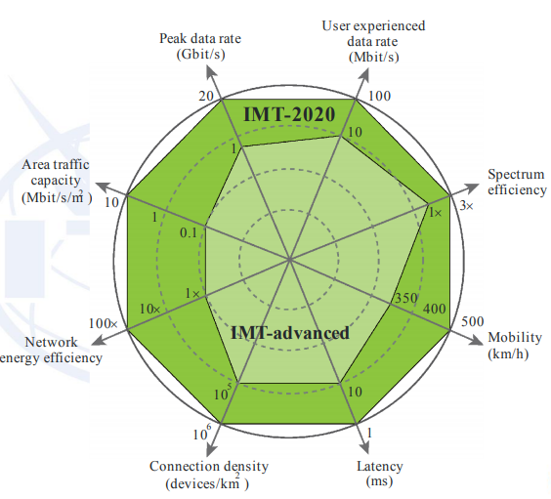
Enhancement of key capabilities from IMT - Advanced to IMT -2020
CREDIT TO OFFICIAL ITU WEBSITE

Slide 14
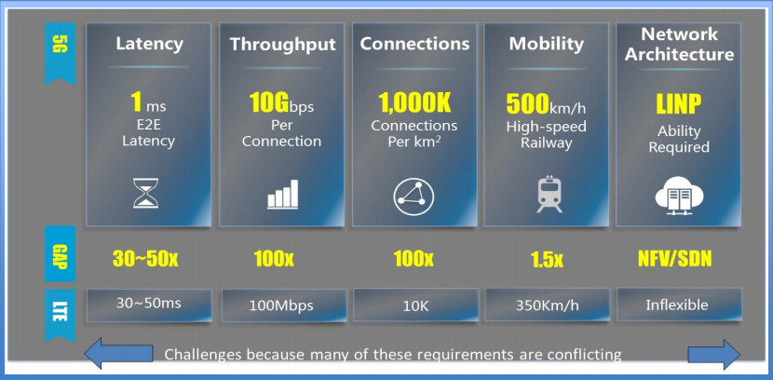
Advantages of IMT 2020

Slide 15
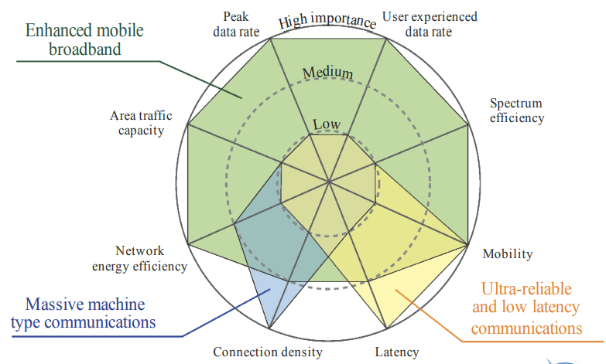
The importance of key capabilities in different usage scenarios
CREDIT TO OFFICIAL ITU WEBSITE

Slide 16
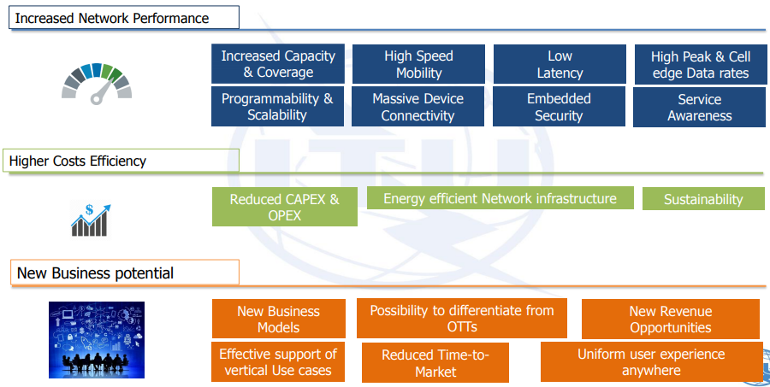
Benefits of 5g and its revenue
CREDIT TO OFFICIAL ITU WEBSITE

Slide 17
ITU-R STUDIES DATA
ITU-R – radio standards and spectrum
SG1 - spectrum management, licensing, short range devices, cognitive radio
SG3 – propagation studies – incl. studies > 6 GHz
SG4 – satellite systems
SG5 – machine-type comms, intelligent transport systems, sensor networks, IMT
ITU-T – fixed network aspects
SG13 - Future networks (& cloud)
SG20 - IoT and applications, smart cities
Focus Group on IMT-2020 (FG IMT-2020)

Slide 18
CREDITS & REFERENCE LINKS
https://en.wikipedia.org/wiki/IMT-2020#:~:text=International%20Mobile%20Telecommunications%2D2020%20(IMT,5G%20networks%2C%20devices%20and%20services.
https://www.itu.int/en/ITU-R/study-groups/rsg5/rwp5d/imt-2020/Pages/default.aspx
https://en.wikipedia.org/wiki/List_of_5G_NR_networks
https://en.wikipedia.org/wiki/5G_NR

Slide 19


